Slide 1
LOGIN360
MOHANPRASATH S

Slide 2
PROJECT :
TOPIC : )
DEPLOYING 10 MICROSERVICES USING
CI/CD USING JENKINS AND AMAZON EKS

Slide 3
CONNECT INSTANCE
Step 1:
Setting Up Your EC2 Instance
First, launch an EC2 instance that will act as the central point for configuring and managing your Kubernetes cluster, Jenkins, and the deployment pipeline.
EC2 Instance: Use a t2.large instance type running Ubuntu.

Slide 4
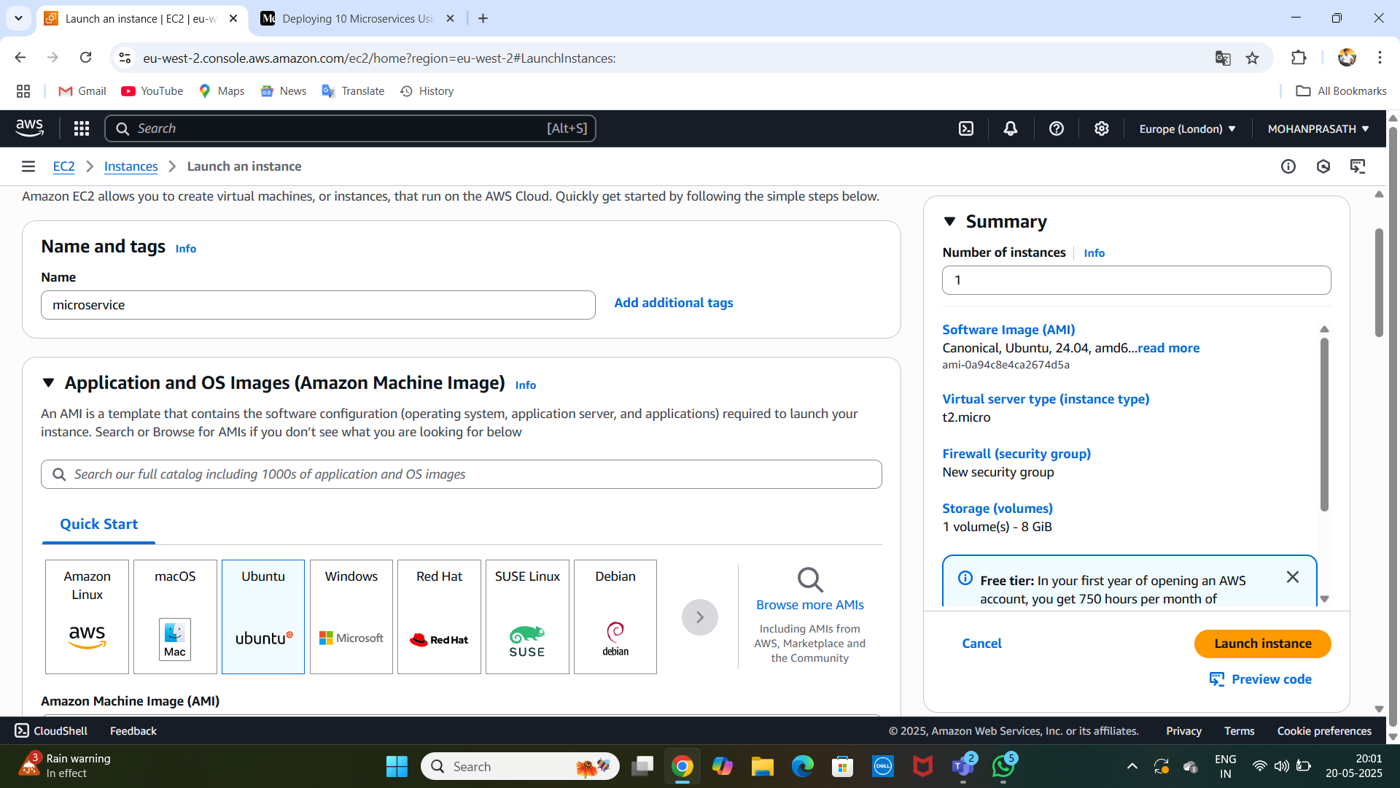
..

Slide 5
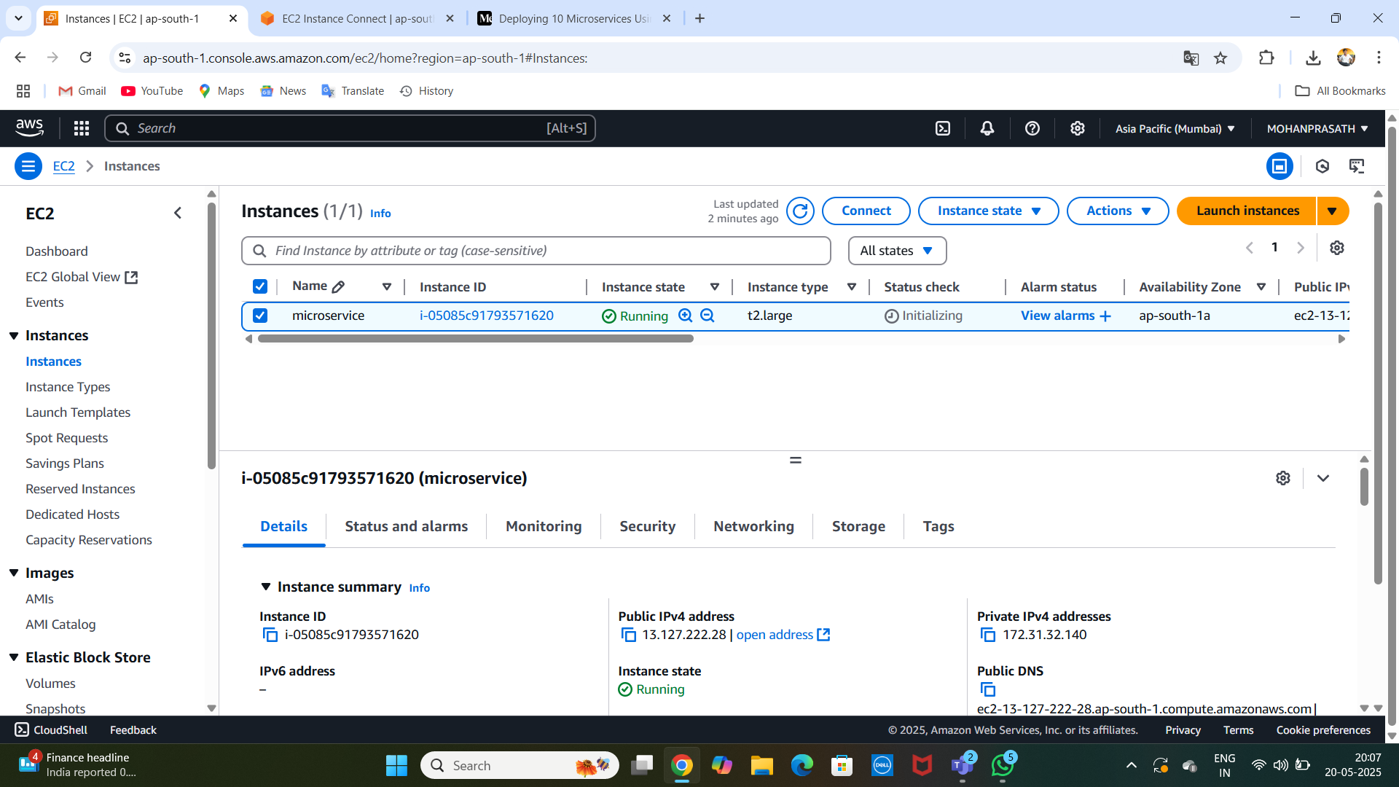
LAUNCHED :

Slide 6
IAM POLICY CREATED :
Next, create a new IAM user with specific policies that allow it to interact with AWS services such as EKS, EC2
IAM Policies to attach to the user:
AmazonEC2FullAccess
AmazonEKSClusterPolicy
AmazonEKSWorkerNodePolicy
AWSCloudFormationFullAccess
IAMFullAccess

Slide 7
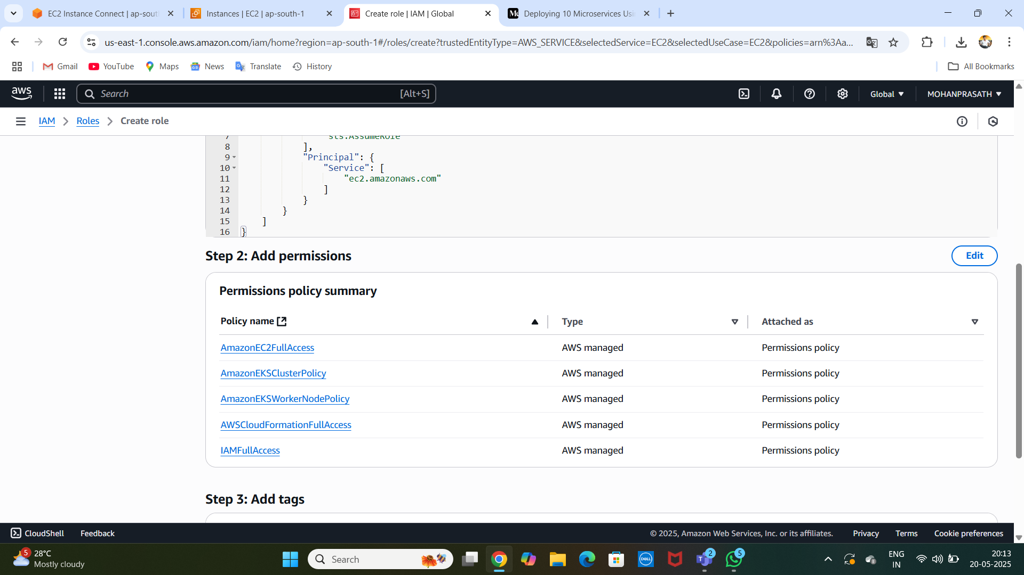
[POLICY ADDED ] :

Slide 8
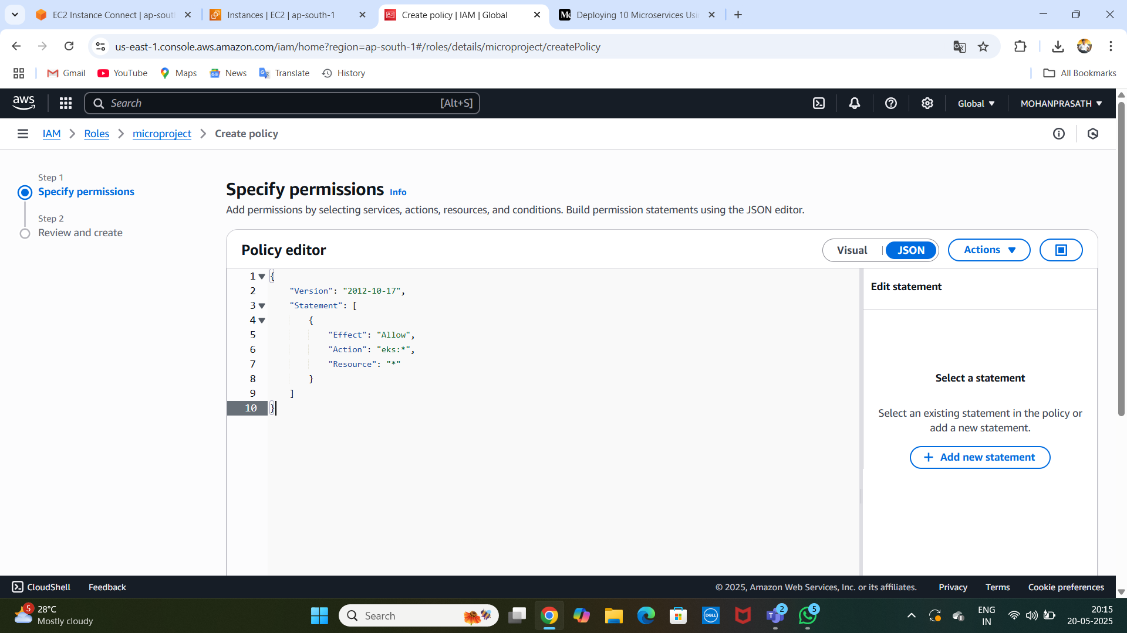
create a custom policy named eks_policy JSON configuration:

Slide 9
Step 3: Install AWS CLI, kubectl, and eksctl
AWS CLI Installation:
curl "https://awscli.amazonaws.com/awscli-exe-linux-x86_64.zip" -o "awscliv2.zip"
sudo apt install unzip
unzip awscliv2.zip
sudo ./aws/install
kubectl Installation:
curl -o kubectl https://amazon-eks.s3.us-west-2.amazonaws.com/1.19.6/2021-01-05/bin/linux/amd64/kubectl
chmod +x ./kubectl
sudo mv ./kubectl /usr/local/bin
kubectl version --short --client

Slide 10
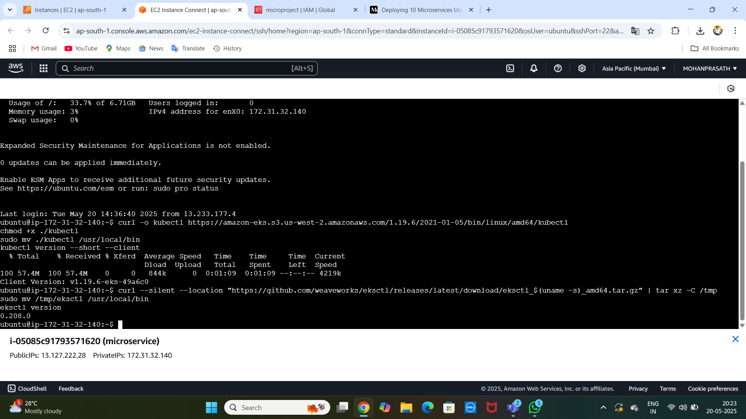

Slide 11
Step 4: Configure AWS CLI
You will be prompted to enter:
Access Key
Secret Key
Default region (e.g., ap-south-1)
Output format (e.g., json)

Slide 12
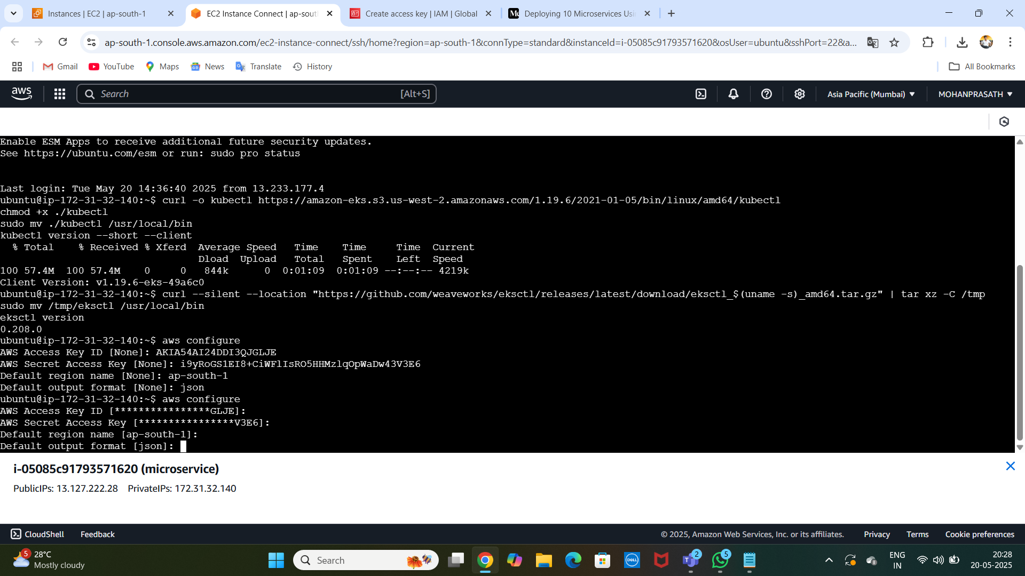
CONFIGURE :

Slide 13
Step 5: Create EKS Cluster
eksctl Installation:
// curl --silent --location "https://github.com/weaveworks/eksctl/releases/latest/download/eksctl_$(uname -s)_amd64.tar.gz" | tar xz -C /tmp
sudo mv /tmp/eksctl /usr/local/bin
eksctl version //
CONFIGURATION :
eksctl create cluster --name=EKS-1 --region=ap-south-1 --zones=ap-south-1a,ap-south-1b --without-nodegroup

Slide 14
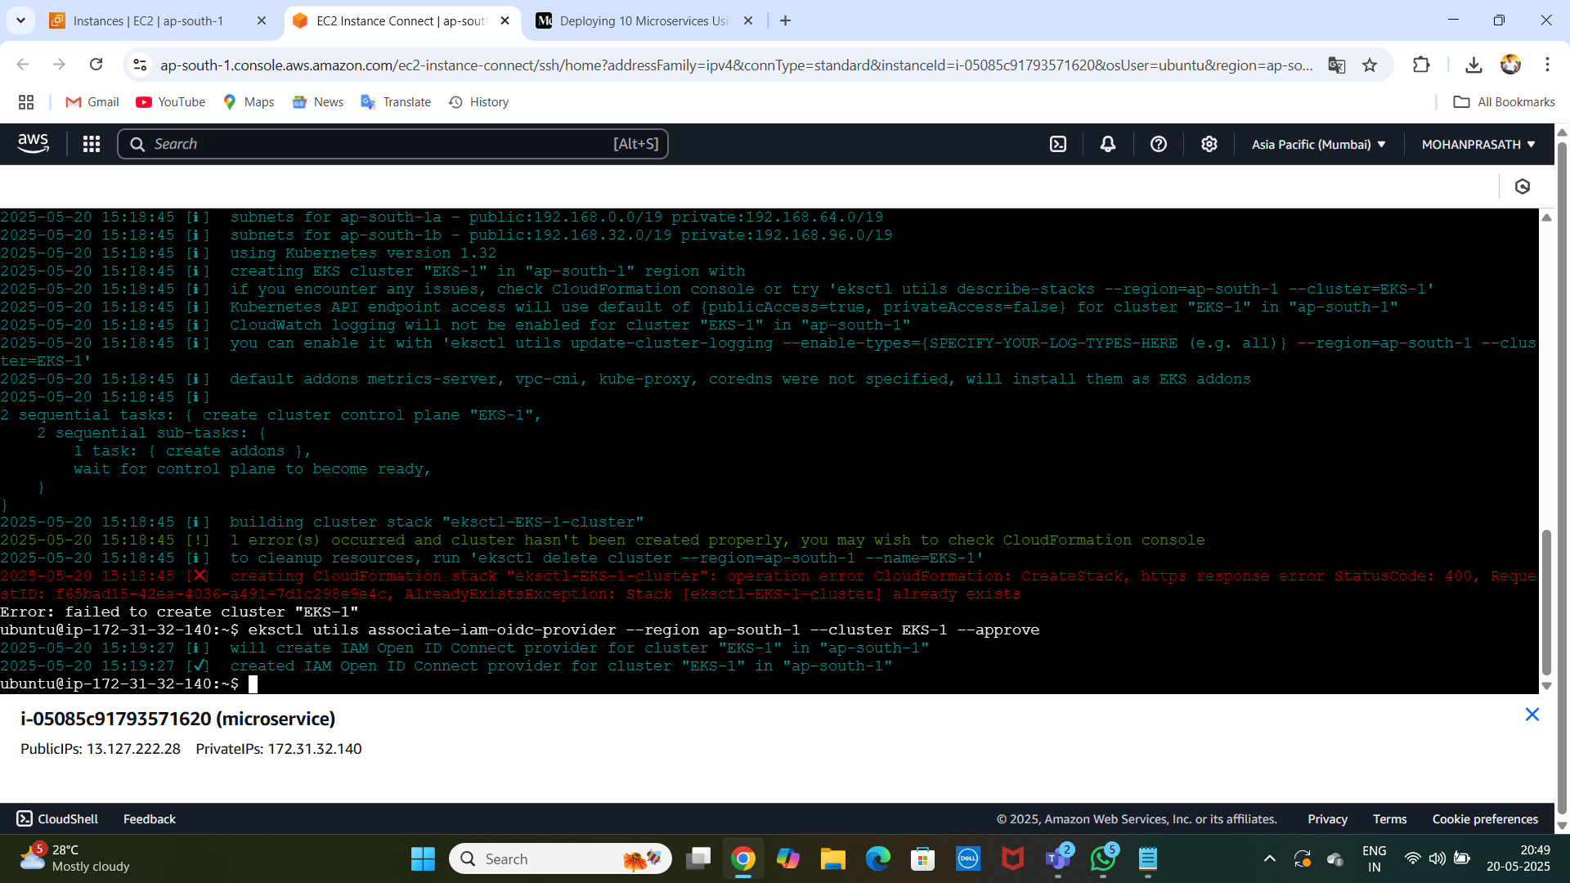
# Associate OIDC Provider (required for IAM roles):

Slide 15
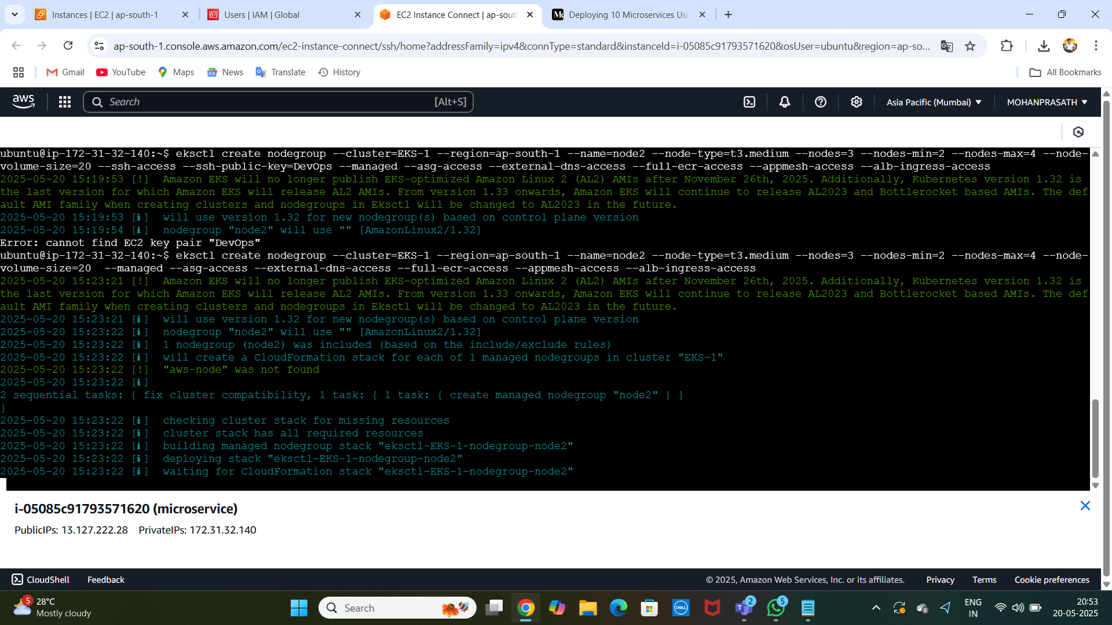
Create Node Group:

Slide 16
Step 6: Install Jenkins on EC2 Instance
Install Java:
sudo apt install openjdk-17-jre-headless
sudo wget -O /usr/share/keyrings/jenkins-keyring.asc https://pkg.jenkins.io/debian-stable/jenkins.io-2023.key
echo "deb [signed-by=/usr/share/keyrings/jenkins-keyring.asc] https://pkg.jenkins.io/debian-stable binary/" | sudo tee /etc/apt/sources.list.d/jenkins.list > /dev/null
sudo apt-get update
sudo apt-get install jenkins

Slide 17
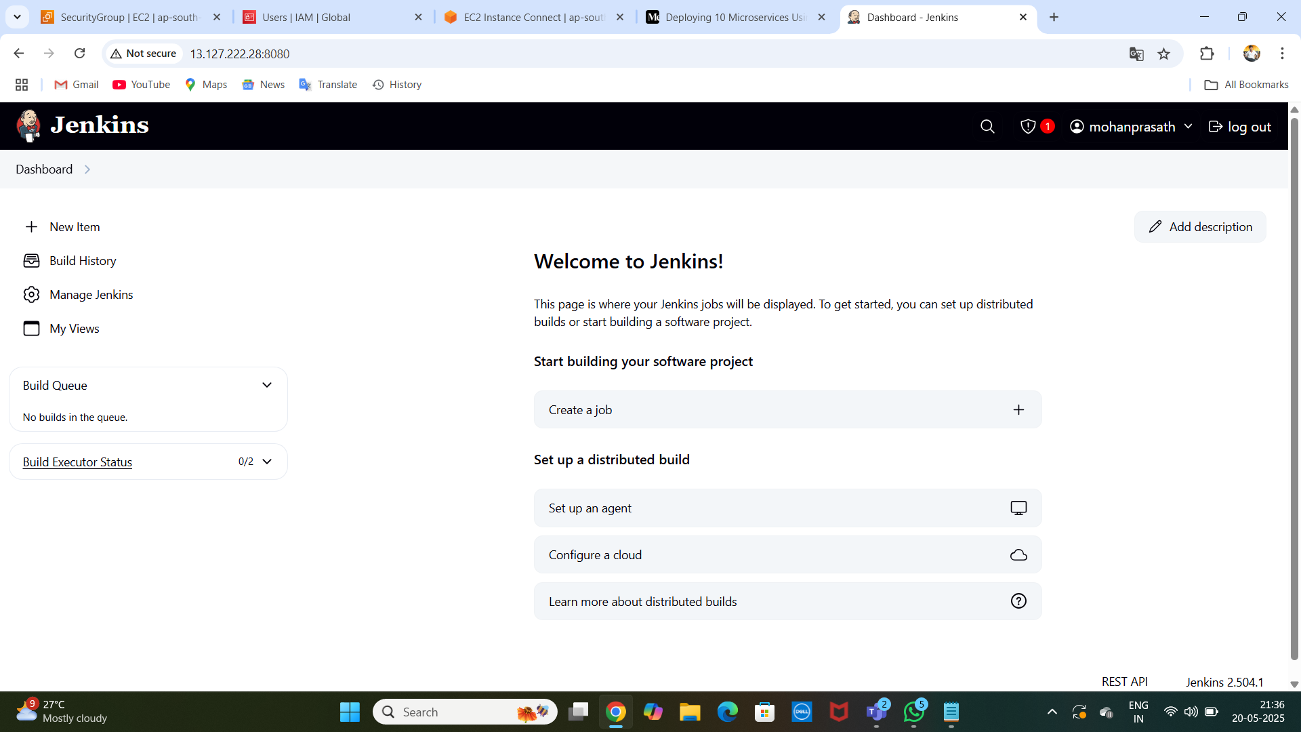
JENKINS DASHBOARD :

Slide 18
TOOLS :
Install Plugins: Install the following Jenkins plugins:
Docker
Docker Pipeline
Kubernetes
Kubernetes CLI

Slide 19
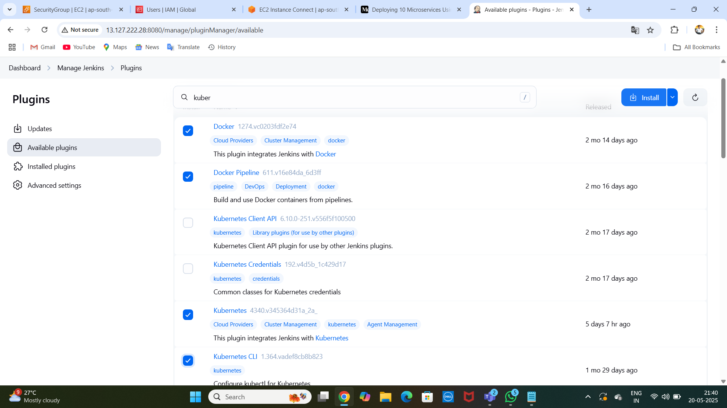
TOOLS :

Slide 20
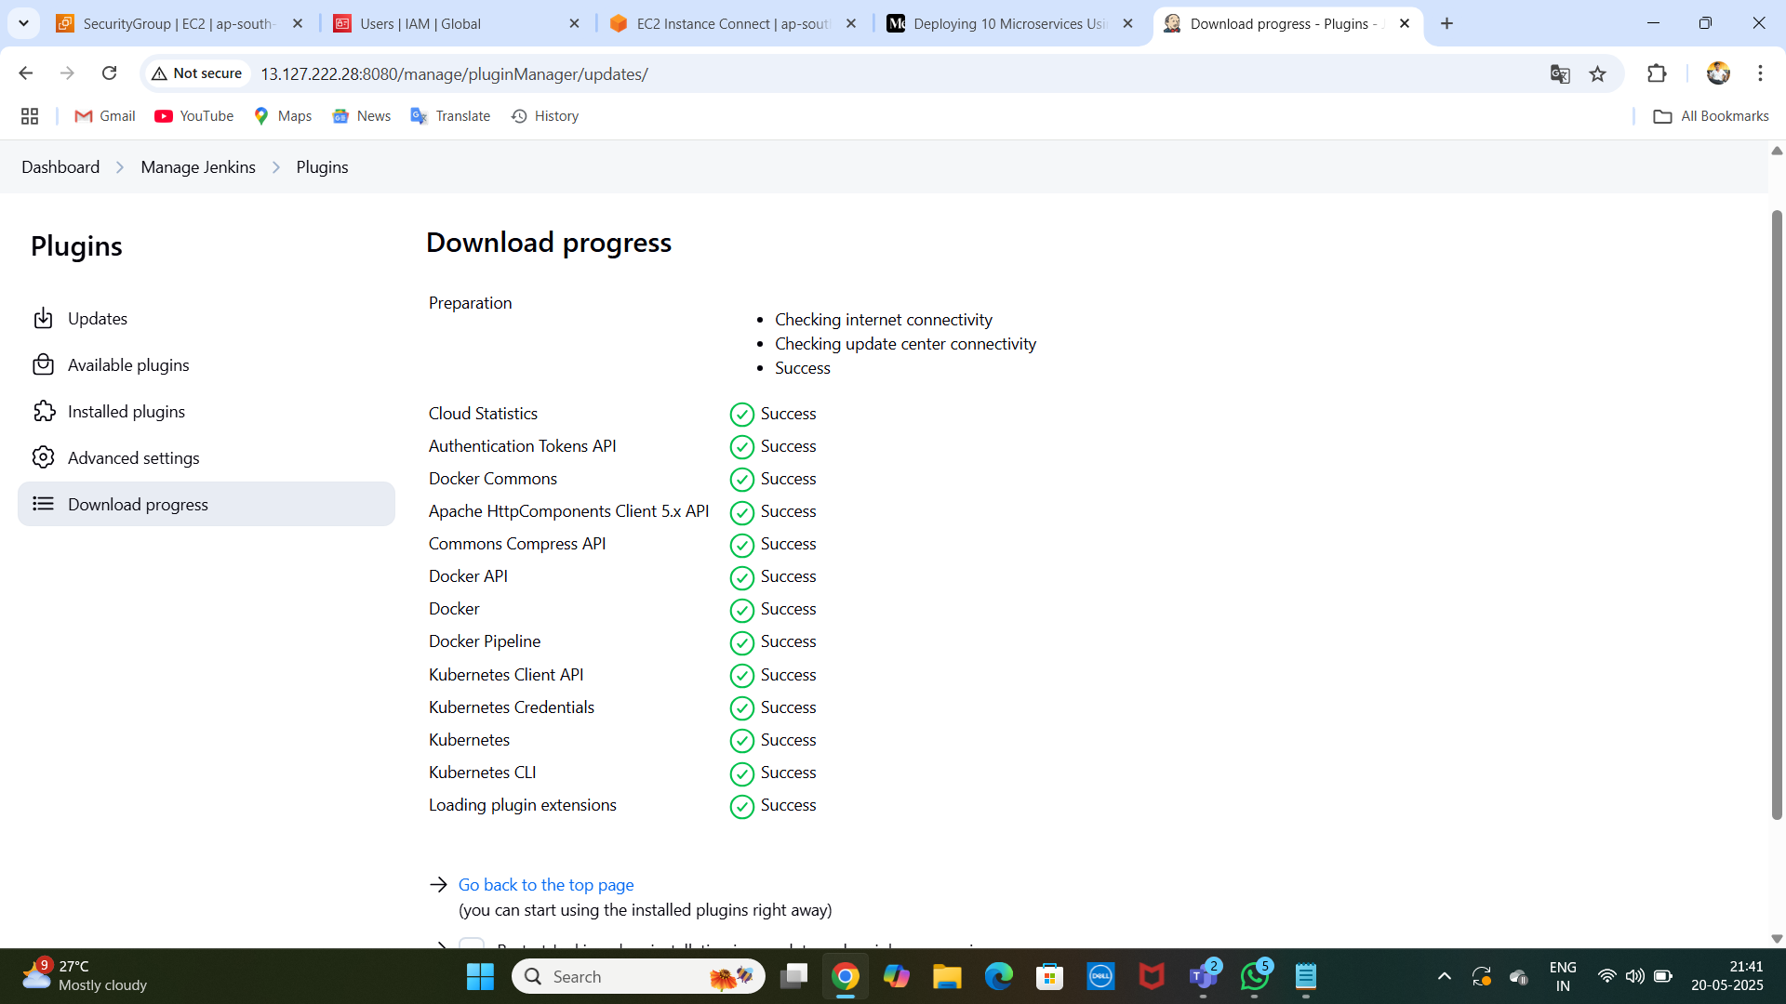
SUCCESFULL : )

Slide 21
4. Install Docker: Install plugins
sudo apt install docker.io -y
sudo chmod 666 /var/run/docker.sock

